Slide 1

1
REAL TIME CROWD MONITORING AND MASK DETECTION
PRESENTED BY
Arav V Varghese
Aravind PB
Parvathy S
GUIDED BY
Asst.Prof.Josemary

Slide 2
2
CONTENTS
Introduction
Literature Survey
Proposed Model
UML Diagrams
Implementation
Conclusion

Slide 3
INTRODUCTION
3
The COVID-19 pandemic has had devastating health and economic consequences, with unprecedented disruption to people's lives, the global economy and world trade.
The proposed model can be integrated with Surveillance Cameras to impede the COVID-19 transmission by allowing the detection of people who are wearing masks and people not wearing face masks.
The crowd has also to be monitored to hinder the spread of covid.The number of people in a specific place have to be counted and be made sure its below the limit.
Proper social distancing also have to be ensured.The distance between people have to be measured and made sure they are not in close proximity to one another.

Slide 4
4
LITERATURE SURVEY

Slide 5
OBJECTIVE | METHODOLOGY | ADVANTAGE | DISADVANTAGE
People Monitoring and Mask Detection using Real-time video. | Converts a color image into binary. People counting methods based on head detection and tracking. | As the system trains itself by doing the same tasks of mask detection so that there is less loss and provides better accuracy. | Tough estimation of the background scene.
Covid-19 Face Mask Detection Using TensorFlow, Keras and OpenCV | Data preprocessing:Data visualization Conversion of RGB to gray scale Image reshaping and then training the model using CNN. | The system can efficiently detect partially occluded faces either with a mask or hand. | The challenges faced by the method is mainly varying angles and lack of clarity.
Deep Learning Based Face Mask Detection and Crowd Counting. | Image goes through the feature extraction stage.SSD is used for the presence of object class instances. | High speed outputs with higher accuracy. | Higher computation time.
Face Mask And Crowd Detection Using Pytorch and MultiTask Cascade Convolutional Neural Network. | Results from MTCNN model that is used to detect faces and extract features for detection of crowds. | Can be deploy into any existing system while keeping the security and privacy of user’s data. | slow detection process and complex methodology
5

Slide 6
OBJECTIVE | METHODOLOGY | ADVANTAGE | DISADVANTAGE
Face Counting and Mask Detection using Deep Learning. | Dataset has training and testing data.AI based algorithms learn from the historical data to provide predictions for the future outcomes. | Easier to deploy the model to embedded systems. | Size of the data.
Facemask Detection With an Alarm System and Email Notification Using Deep Learning to Prevent Spread of COVID-19. | We adopted OpenCV, Keras, tensor flow, and mobilenetV2 to specify whether people were wearing face masks or not.This model was biult using Mobile Net V2 | Works better on mobile devices. | Computation speed.
NoBis: A Crowd Monitoring Service Against COVID-19 | The entire platform is based on the use of QR codes which users scan each time they enter and exit. | Can be used to know how crowded a place before visiting. | Difficult to use in large communities.
Social Distancing Detection with Deep Learning Model | YOLOv3 algorithm was employed for pedestrian detection.Later, the video frame was transformed into top-down view for distance measurement from the 2D plane. | Speed advantages suitable for real-time application. | Computationally expensive.
6

Slide 7
OBJECTIVE | METHODOLOGY | ADVANTAGE | DISADVANTAGE
Implementing a real-time, AI-based, people detection and social distancing measuring system for Covid-19. | The proposed approach is applied to images acquired through thermal cameras, to establish a complete AI system for people tracking, social distancing classifcation, and body temperature monitoring. | Can perform body temperature analysis. | Comparatively low recall and more localization error.
Person Detection for Social Distancing and Safety Violation Alert based on Segmented ROI | MobileNet Single Shot Multibox Detector (SSD) object tracking model and OpenCV library for image processing. | SSD has lower localization error. | SSD does worse for smaller objects than bigger objects.
Masked Face Detection Algorithm in the Dense Crowd Based on Federated Learning | A cascaded network is proposed: first is DRFL, the second is the SRNet20 network. | The purpose of masked face detection in dense crowds is achieved. | Long-distance faces that are blurred or severely occluded.
Social Distancing Detection Using Computer Vision | This paper proposes optimized faster region-based convolutional neural network methodology, which runs in real-time and is built using a Faster R-CNN, which is used for object detection | Drastically improves the training and detection time | All samples from a single image may be correlated (i.e. their features are similar), the network may take a lot of time until reaching convergence.
7

Slide 8
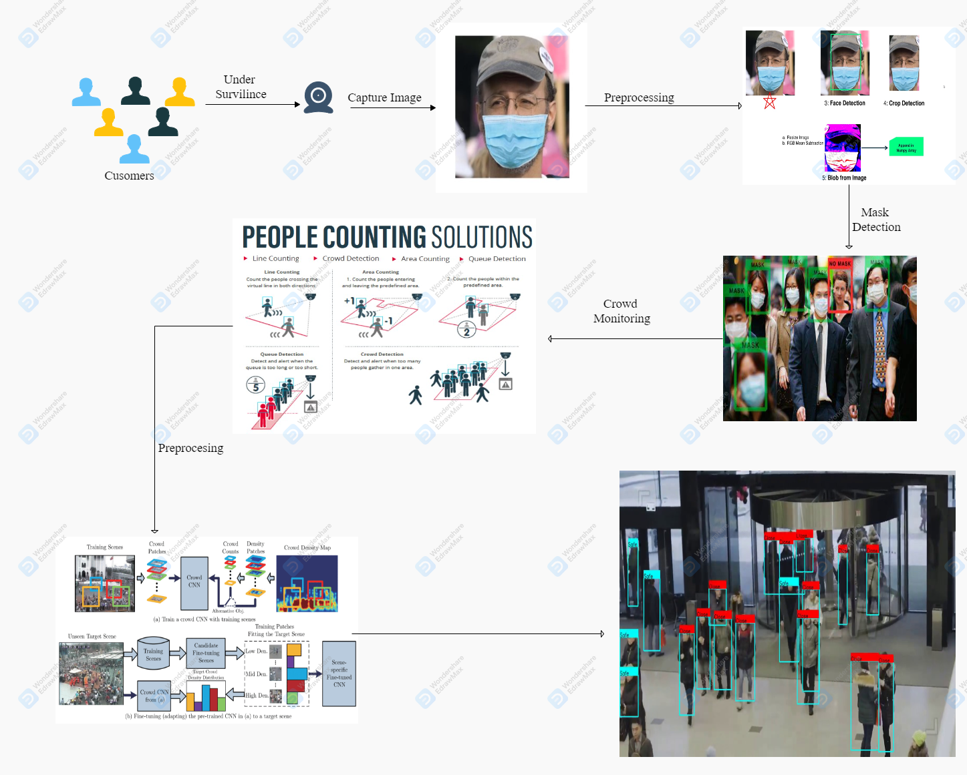
PROPOSED METHODOLOGY
8

Slide 9
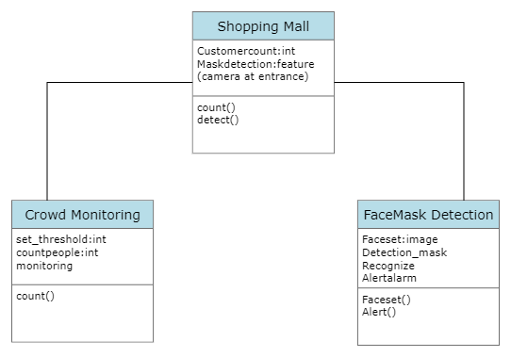
9
UML DIAGRAMS
CLASS DIAGRAM

Slide 10
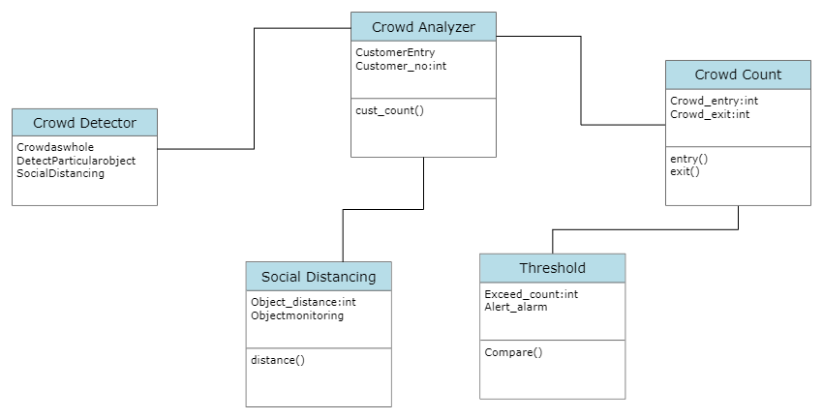
10

Slide 11
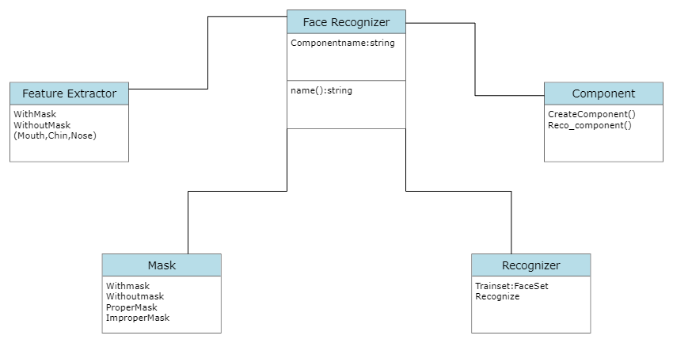
11

Slide 12
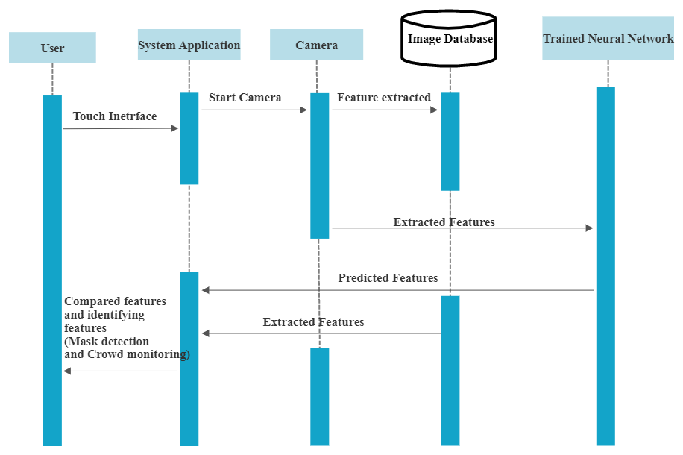
12
SEQUENTIAL DIAGRAM

Slide 13
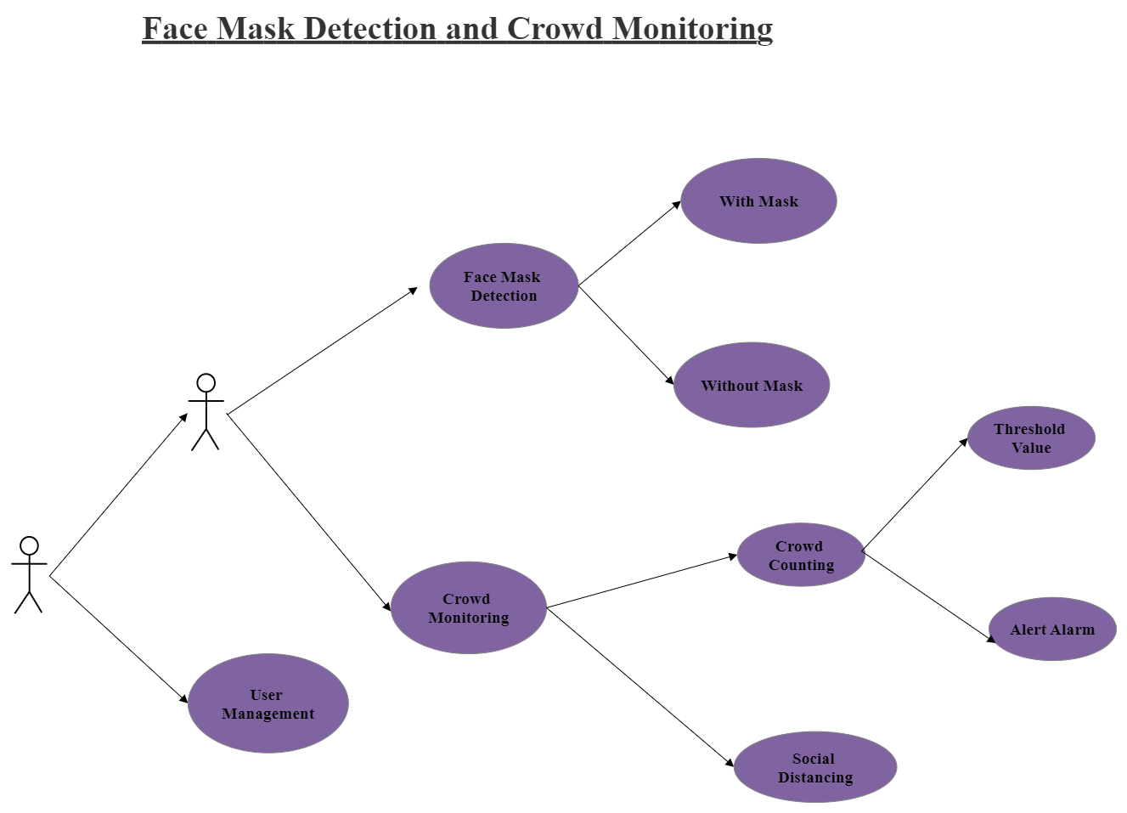
13
USECASE DIAGRAM

Slide 14
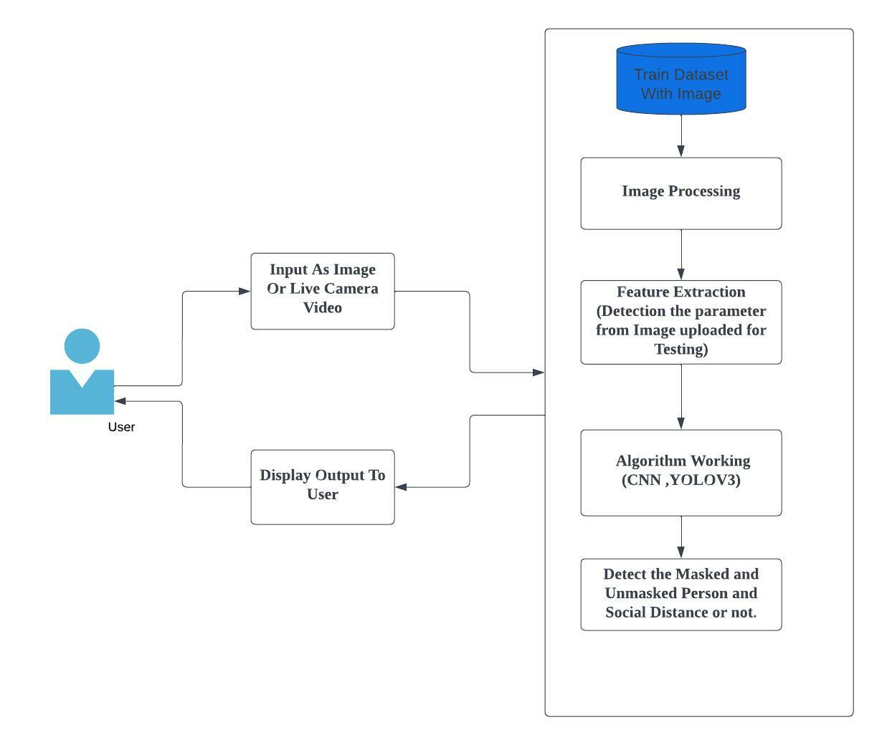
14
WORK FLOW DIAGRAM PROPOSED SYSTEM

Slide 15
15
IMPLEMENTATION
The project aims at real time face mask detection and social distancing of people.
We have completed the mask detection module using deep learning.
We have used python,open cv,tensor flow and caffe model.
The prediction accuracy obtained is .992264.
The crowd monitoring and social distancing modules have
We’ll be using the YOLO object detector to detect people in our video stream.
Using YOLO with OpenCV requires a bit more output processing than other object detection methods (such as Single Shot Detectors or Faster R-CNN)

Slide 16
16
Open CV: OpenCV provides a real-time optimized Computer Vision library, tools, and hardware.
Tenserflow:TensorFlow is an open-source library developed by Google primarily for deep learning applications.
MobileNetV2: It is a convolutional neural network architecture that seeks to perform well on mobile devices. It is based on an inverted residual structure where the residual connections are between the bottleneck layers. The intermediate expansion layer uses lightweight depthwise convolutions to filter features as a source of non-linearity.

Slide 17
17
YOLO V3: (You Only Look Once, Version 3) is a real-time object detection algorithm that identifies specific objects in videos, live feeds, or images. YOLO uses features learned by a deep convolutional neural network to detect an object.
SOFTWARE REQUIREMENTS
Visual Studio
Python 3.x
HARDWARE REQUIREMENTS
Camera
16 GB RAM
Processing Speed 2.9GHz

Slide 18
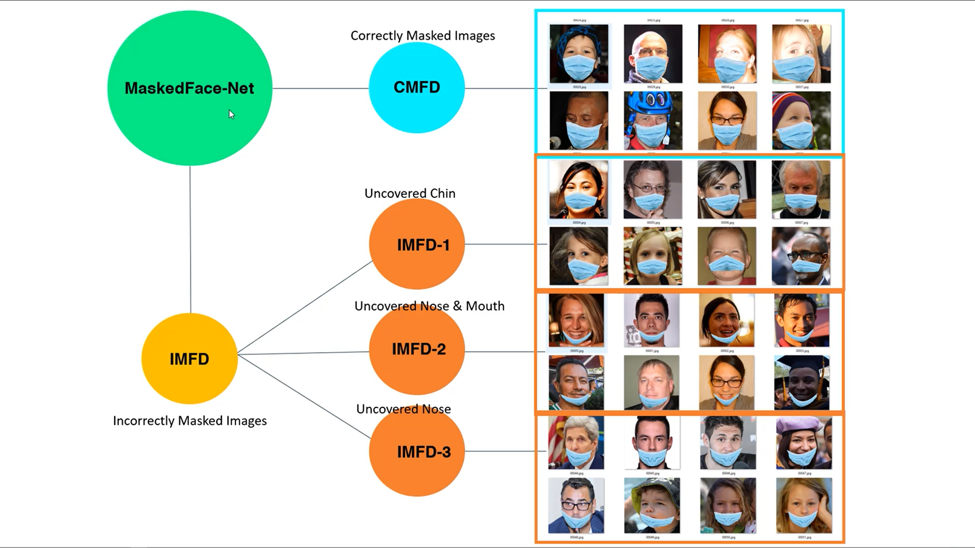
DATASET
18

Slide 19
19
DATA PREPROCESSING
Preprocessing steps as mentioned below was applied to all the raw input images to convert them into clean versions, which could be fed to a neural network machine learning model.
1.First we collect all the images used for training and testing.
2.Then we label them as mask,mask_chin,mask_nose,mask_mouth_nose.
3.Then we detect the faces in the mask using deep neural network and open cv.
4.The required area is cropped for use.
5.RGB mean subtraction is done next, we subtract the RGB value with the mean of the dataset.

Slide 20
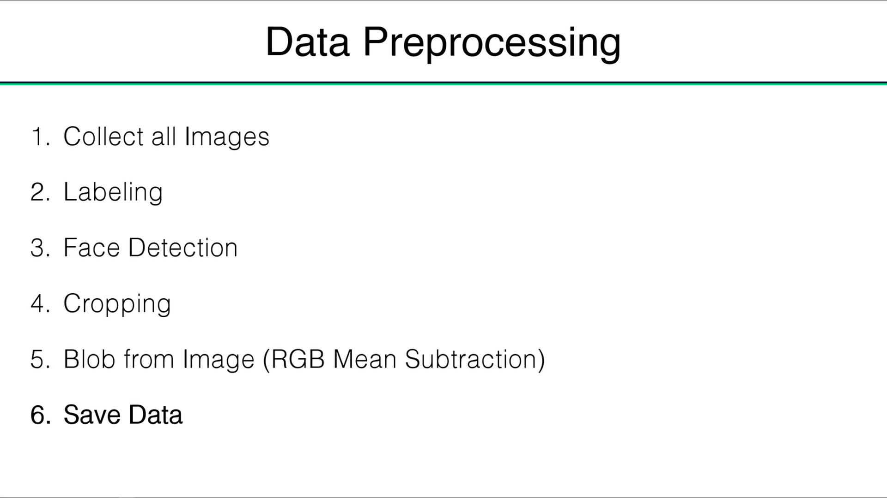
20

Slide 21
21
The dataset is split into two for training and testing.The trained model is saved and is used for
prediction.
Then we will load the trained model then use it for prediction.Each label is given a different color
Implementing the trained model for face detection.
Processing the loaded data and deep learning is applied using CNN.
Then it is connected to a real time camera for real time prediction.

Slide 22
22
ALGORITHM USED
CNN- CNN used in Face mask detection. CNN which takes images frames as an input. After getting frames from image it will processed using image processing techniques for feature evaluation. We extract different features from those images regardless of their events in it consists.
DNN- DNN used in Social Distancing. The use of DNN in our system is to predict the number of counts by taking the input from CNN and the database. Deep neural networks are current the foundation for many modern artificial intelligence applications.

Slide 23
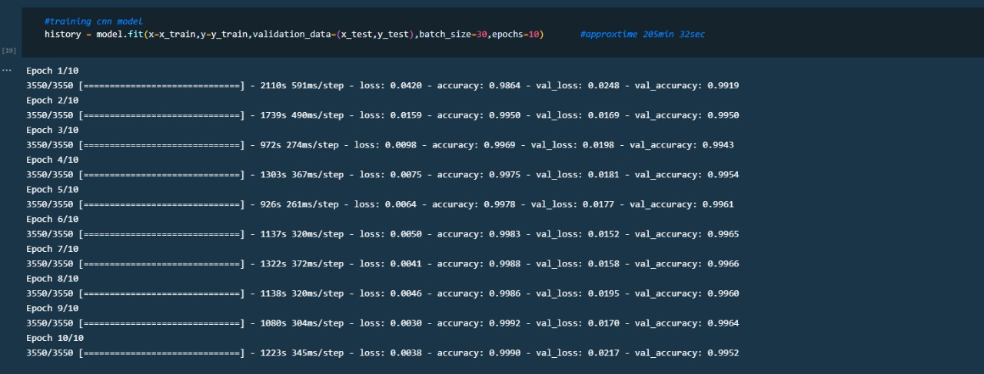
23
TRAINING: 10 epochs

Slide 24
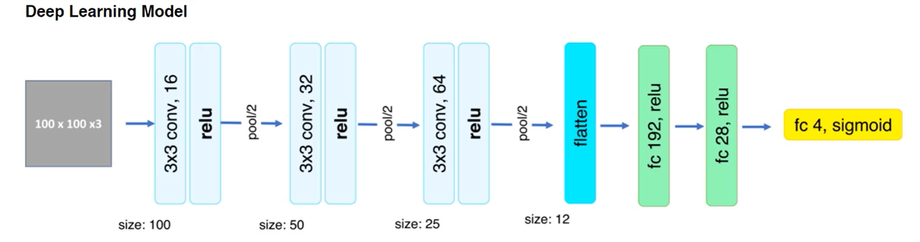
24

Slide 25
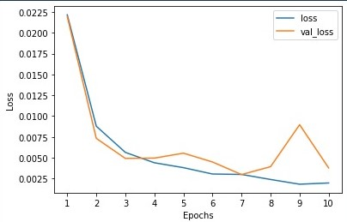
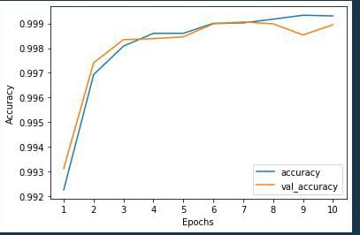
25
ACCURACY:

Slide 26
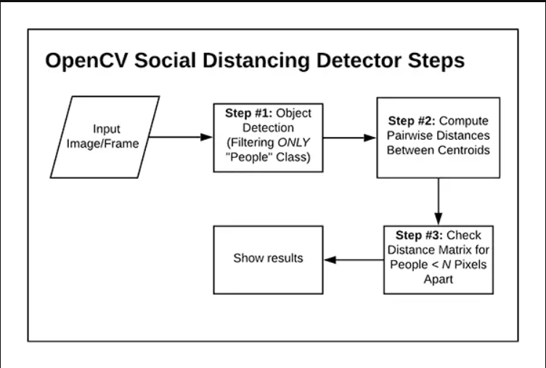
SOCIAL DISTANCING
26
We can use OpenCV, computer vision, and deep learning to implement social distancing detectors.
The steps to build a social distancing detector include:
Apply object detection to detect all people (and only people) in a video stream.
Compute the pairwise distances between all detected people
Based on these distances, check to see if any two people are less than N pixels apart

Slide 27
27
The frame is taken from your video file that have been given as input.
The YOLO model can detect many types of objects, here it is specifically for the person class, as we won’t be considering other objects.
The result consist of
1)Bounding box of each person
2)Centroid of each person
The number of people are also counted after detecting people and is shown in the final result.

Slide 28
28
STEPS IN SOCIAL DISTANCING
1.Data Preprocessing.
2.Training of data.
3.Testing of data.
4. People Detection using YOLO V3.
5. Calculating the Euclidian Distance between the people.
6.Classifying the people according to the distance calculated between them.

Slide 29
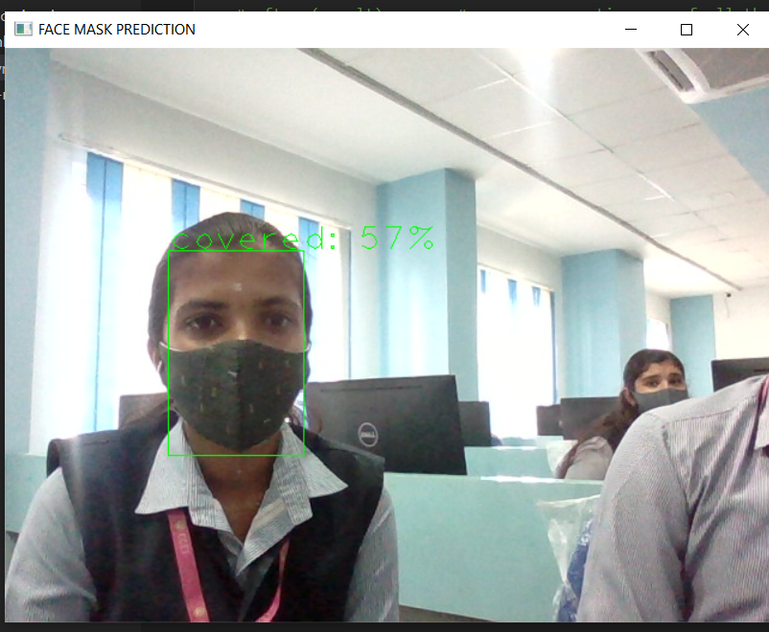
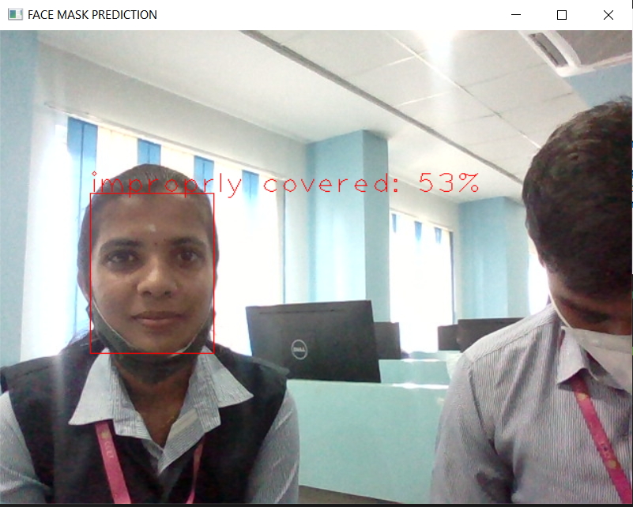
29
RESULT

Slide 30
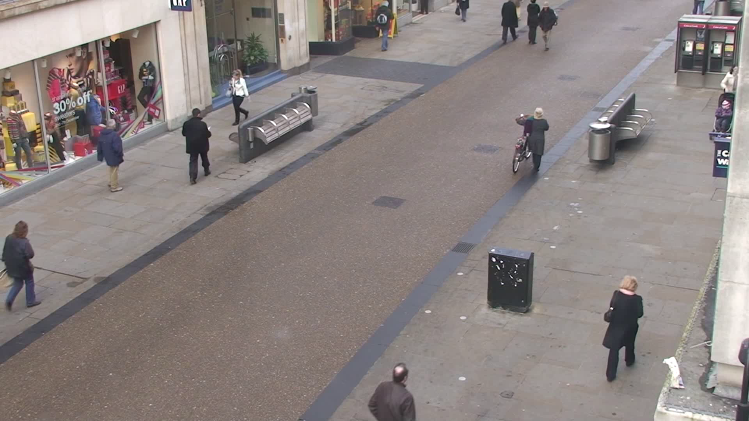
30

Slide 31
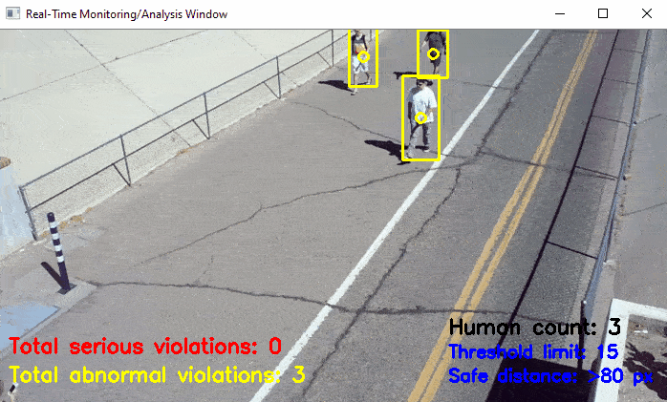
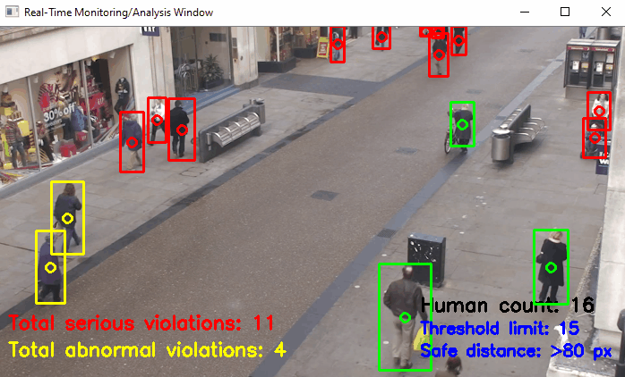
RESULT
31

Slide 32
32
CONCLUSION
This system can prevent the spread of covid-19 by detecting whether people were wearing face masks or not.
This system can be implemented in public areas like malls,theatres,schools etc where there is a gathering of people.
This system can also be implemented in Cement Industries, Chemical Plants, Hospitals where the chance of spread of disease, and at airports to detect travelers without masks.
The proposed model can also be enhanced by means of including various parameters like
peoples count, social distance.

Slide 33
33
REFERENCES
"Face Mask Detection Using OpenCV," 2021 Third International Conference on Intelligent Communication Technologies and Virtual Mobile Networks (ICICV), 2021, pp. 1304-1309, doi: 10.1109/ICICV50876.2021.9388375.
https://pyimagesearch.com/2020/05/04/covid-19-face-mask-detector-with-opencv-keras-tensorflow-and-deep-learning/
https://www.ideas2it.com/blogs/face-mask-detector-using-deep-learning-pytorch-and-computer-vision-opencv/
Y. C. Hou, M. Z. Baharuddin, S. Yussof and S. Dzulkifly, "Social Distancing Detection with Deep Learning Model," 2020 8th International Conference on Information Technology and Multimedia (ICIMU), 2020, pp. 334-338, doi: 10.1109/ICIMU49871.2020.9243478.

Slide 34
THANK YOU

